Slide 1
Federal Income Taxation Ethical Debates, Economic Theories, Real-World Impacts
Prof. Colon
Spring 2025

Slide 2
Tax Policy Issues
Historical background of the US income tax
Source of tax revenues and outlays
Brief look at deficits
Tax Expenditures

Slide 3
U.S. Income Tax: Historical Background
U.S. Constitution
Art. 1, Sec. 8, Cl. 1: “Congress shall have the power to lay and collect Taxes, Duties, Imposts, and Excises”; subject to the uniformity clause.
Indirect tax: excise tax, import tax, sales tax
Art. 1, Sec. 9, Cl. 4: No capitation or other direct tax shall be laid unless in proportion to the census.
What’s a direct tax?
Capitation tax (head tax), Property tax, … vs. transaction tax (sales tax)
Income tax of 1894 held to be a direct tax. Pollack v. Farmers’ Loan & Trust Co., 157 U.S. 429 (1895).
16th Amendment (1913): The Congress shall have power to lay and collect taxes on incomes, from whatever source derived, without apportionment among the several States, and without regard to any census or enumeration.

Slide 4
First Form 1040

Slide 5
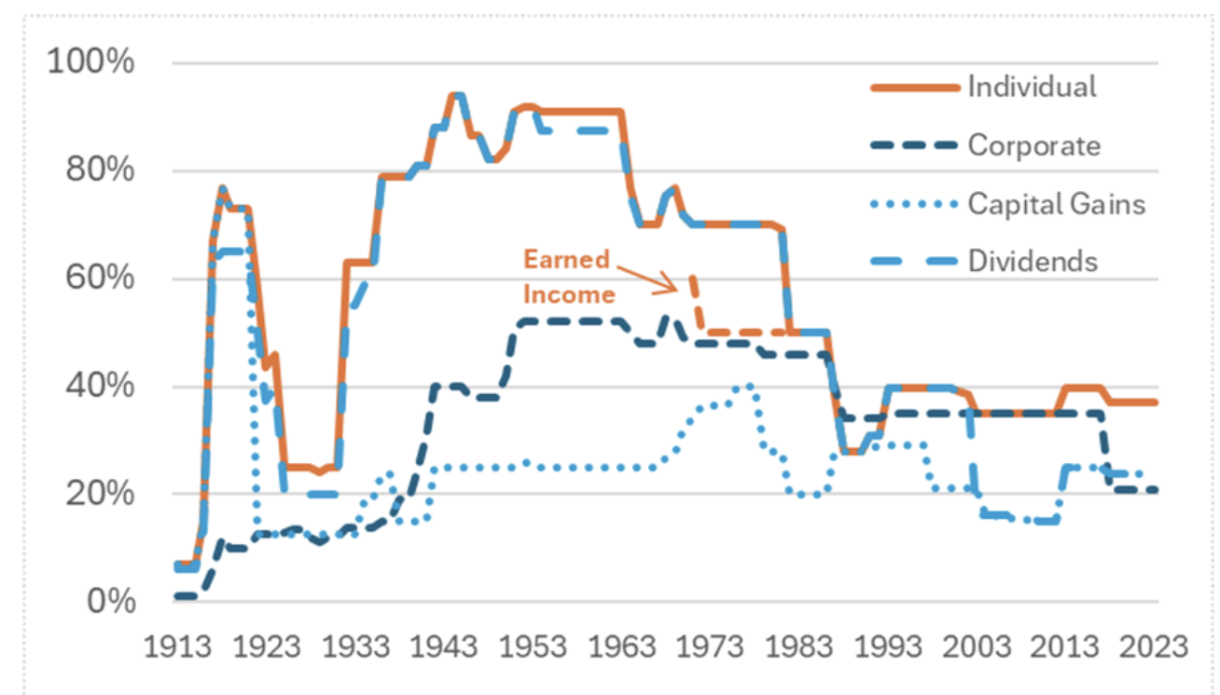
Historical MTRs of Individuals and Corporations

Slide 6
Social Security Taxes on Wages
7.65% [6.2% (OASDI) + 1.45% (Medicare)] to $176,100 (2025) (employers & employees, each). §§3101(a) and (b)(1); 3111(a) and (b).
1.45% (employer & employee) on earned income > $176,100 (2025). §§3101(b)(1) and 3111(b).
0.9% Additional Medicare tax (employee) on earned income > $200,000 (single); 250,000 (joint). §3101(b)(2)
Total:
15.3% up to 176.1K;
2.9% > 176.1K to 200K/250K;
3.8% > 200K/250K

Slide 7
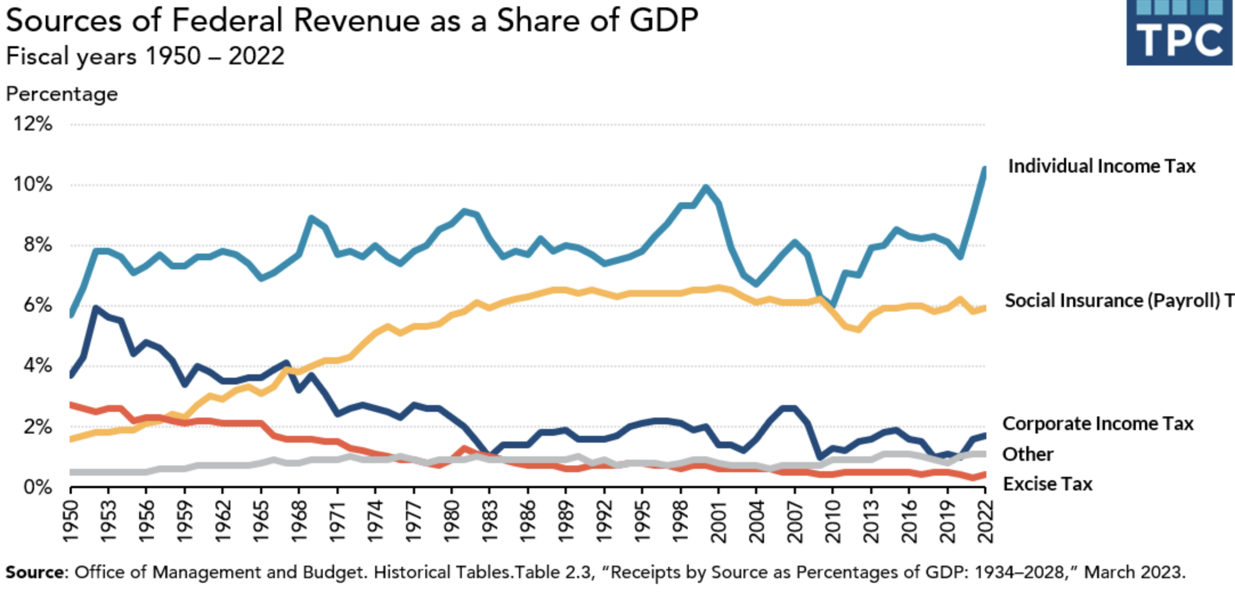
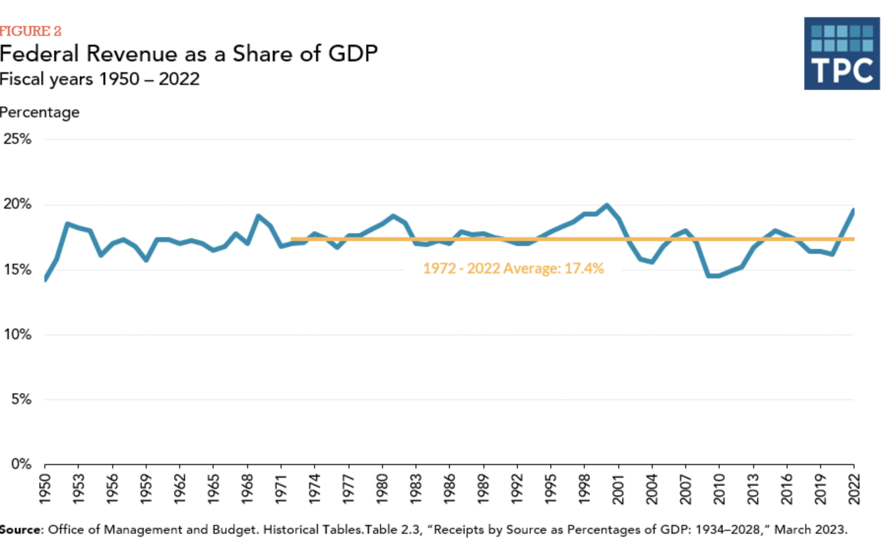
Source of Federal Revenue as a Share of GDP

Slide 8
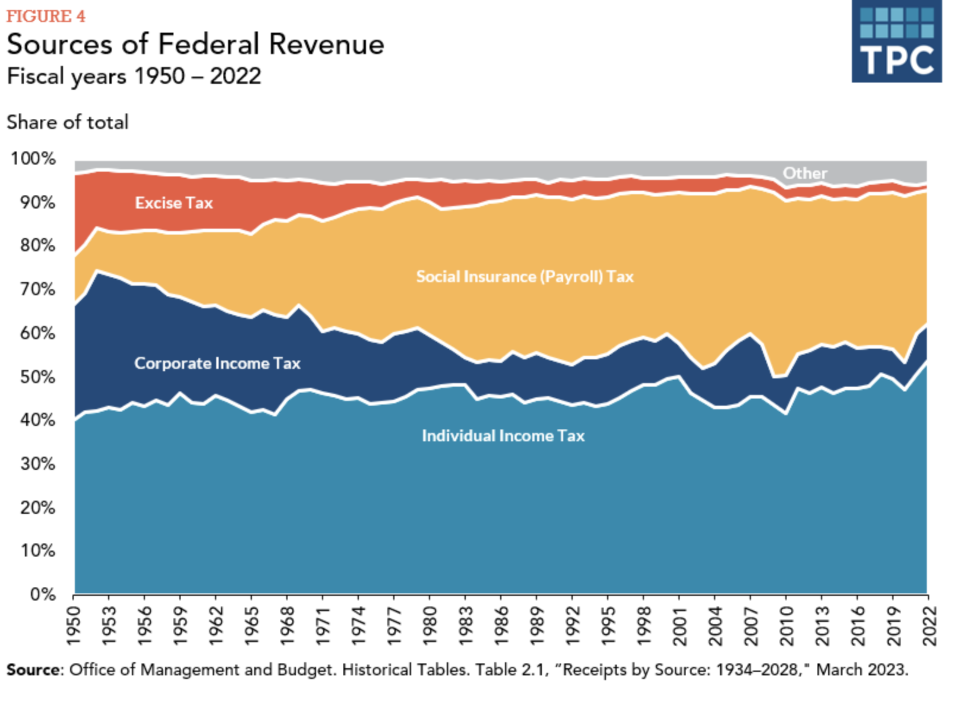
Sources of Federal Revenue

Slide 9
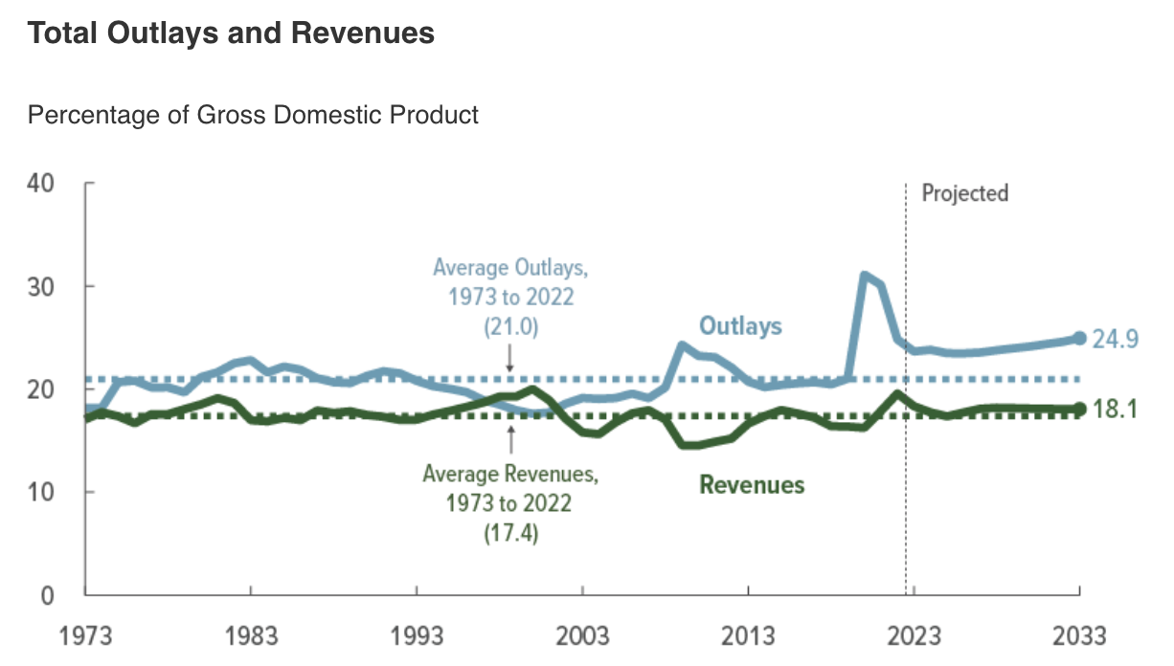
Total Federal Revenues and Outlays as a Percentage of GDP

Slide 10
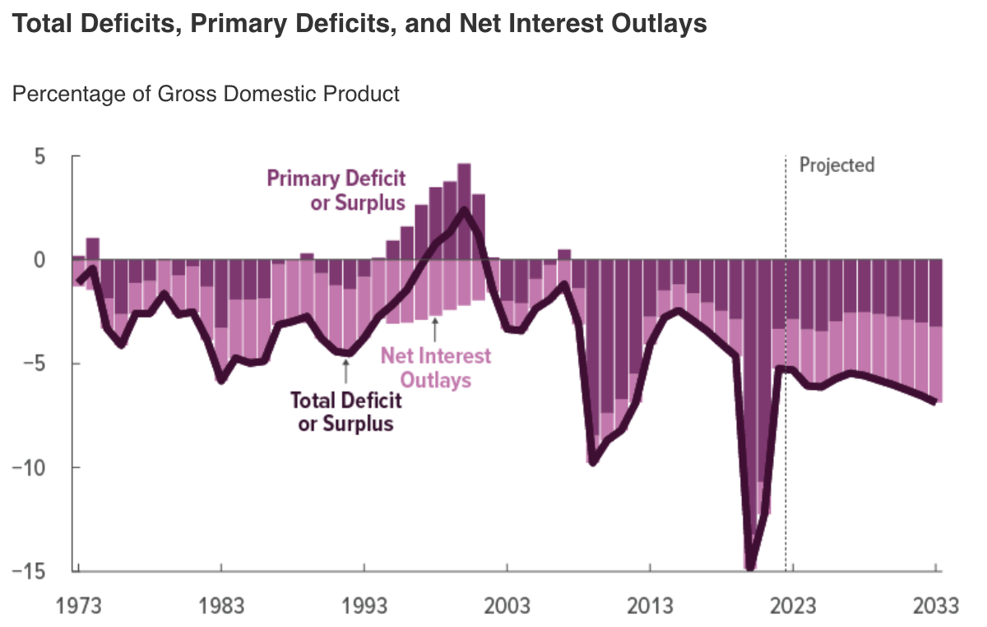
U.S. Deficits: Total, Primary, and Net Interest Outlays

Slide 11
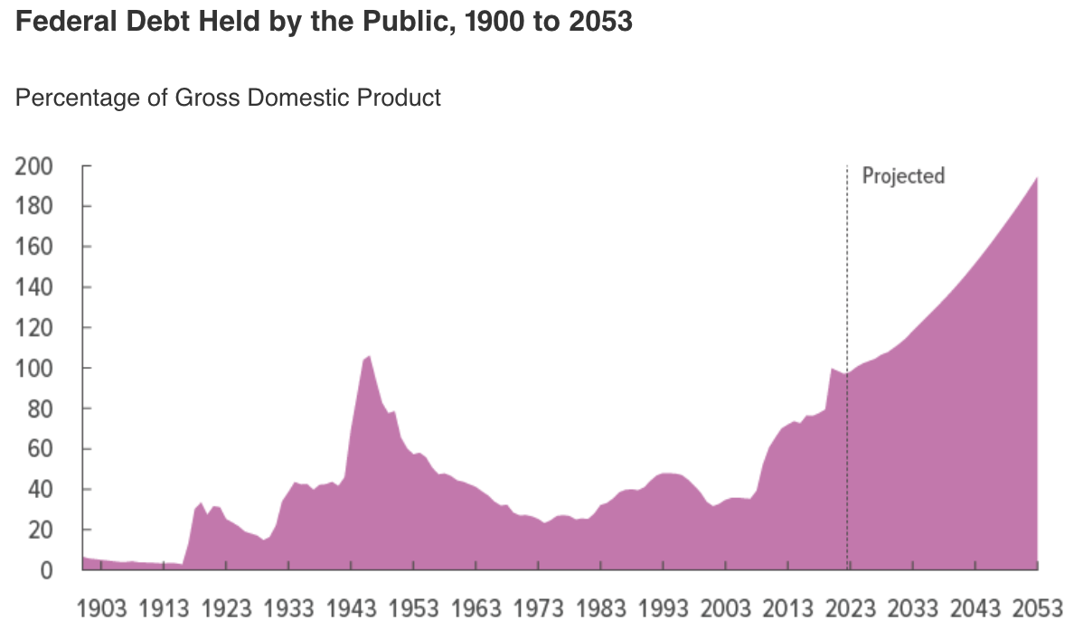
Federal Debt Held by the Public: 1900 to 2050

Slide 12
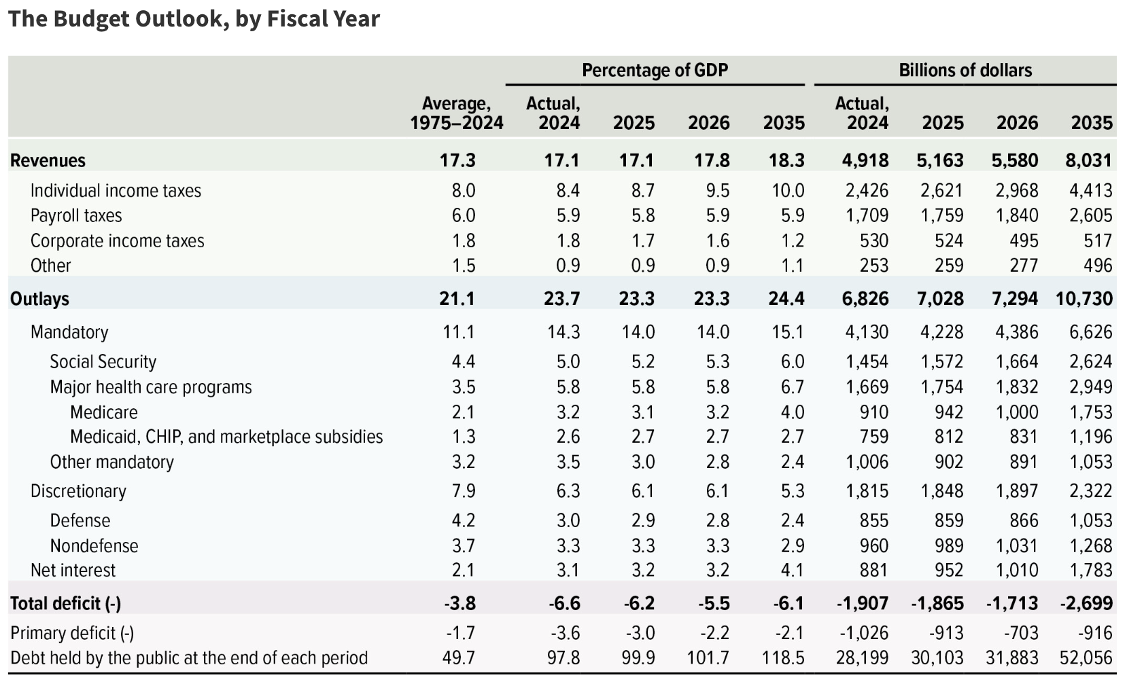
Budget Outlook

Slide 13
Fairness Norms
Horizontal Equity: Similarly situated taxpayers should pay the same tax
Issue: What is similarly situated?
Same consumption, even though different levels of wealth and unrealized gains?
What should be the tax base? Labor? Investment income? Consumption? Wealth? Benefits from gov’t?
Ability-to-Pay norm: tax resources under the control of the taxpayer that are available for contribution to the fisc
Both consumption and amounts saved should be in tax based because they represent ability to pay
Standard-of-living norm: Tax some measure of “utility” (only consumption)

Slide 14
Welfare Economics
Flat Rate Tax Structure: everyone’s effective tax rate (Tax / Income) is the same
Regressive Tax Structure: ETR (Tax / Income) declines as income increases
Social security
Progressive Tax Structure: ETF (Tax / Income) increases as income increases.
Income and Substitution effects

Slide 15
Tax Expenditures
Tax Expenditure: tax provision (deduction, credit, exclusion, etc.) that deviates from core, normative concept of income tax to implement nontax social or economic policy.

Slide 16
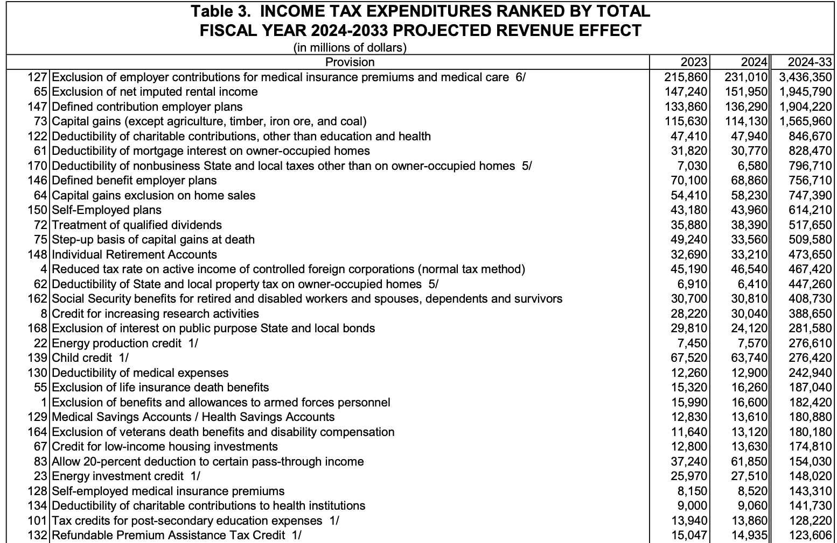
Tax Expenditures (2024-2033) (Treasury)

Slide 17
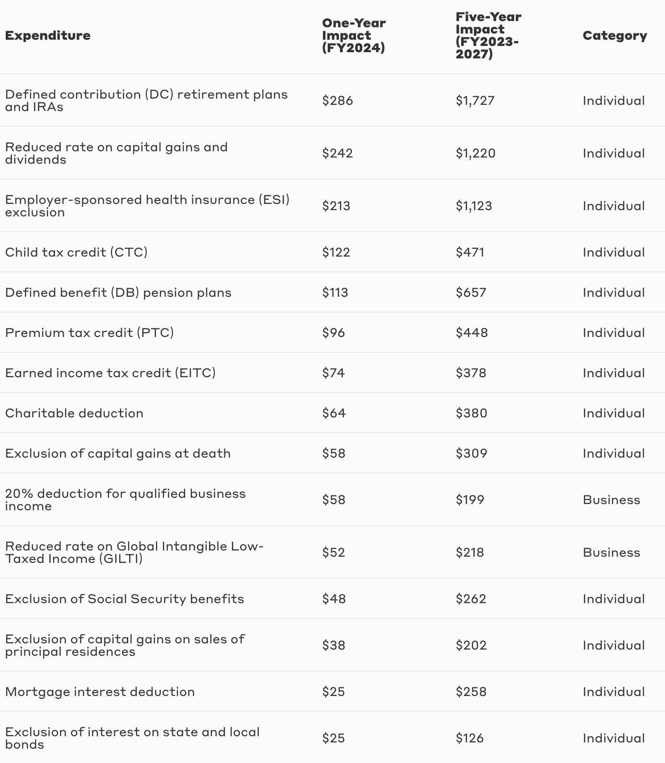
Tax Expenditures (2023-2027) (JCT)

Slide 18
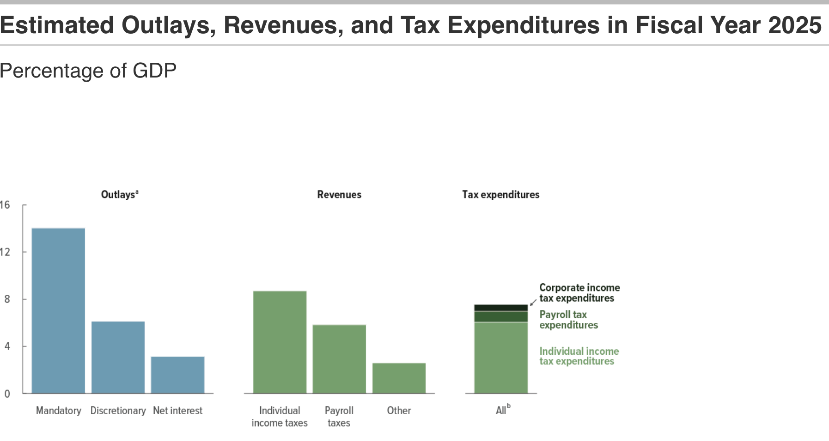
Outlays, Revenues, and Tax Expenditures (2025)

